Slide 1
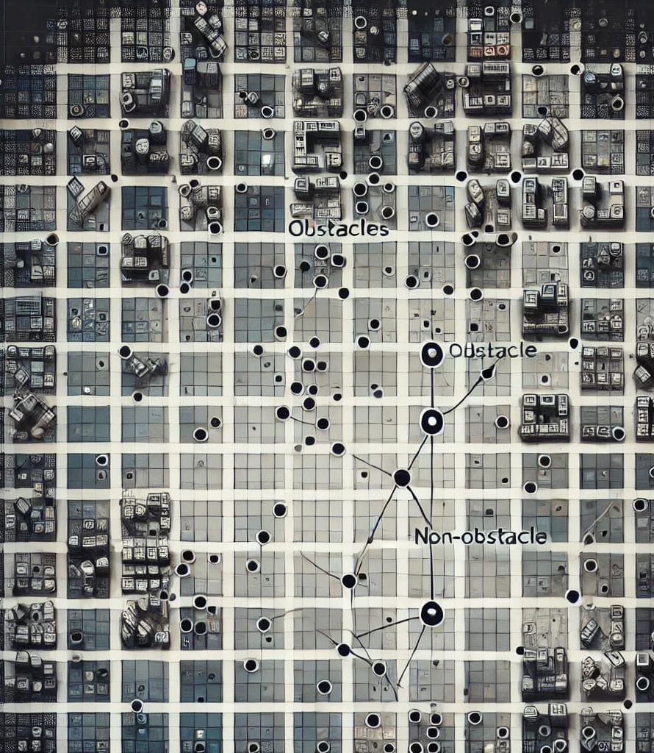
Visibility Learning

Slide 2
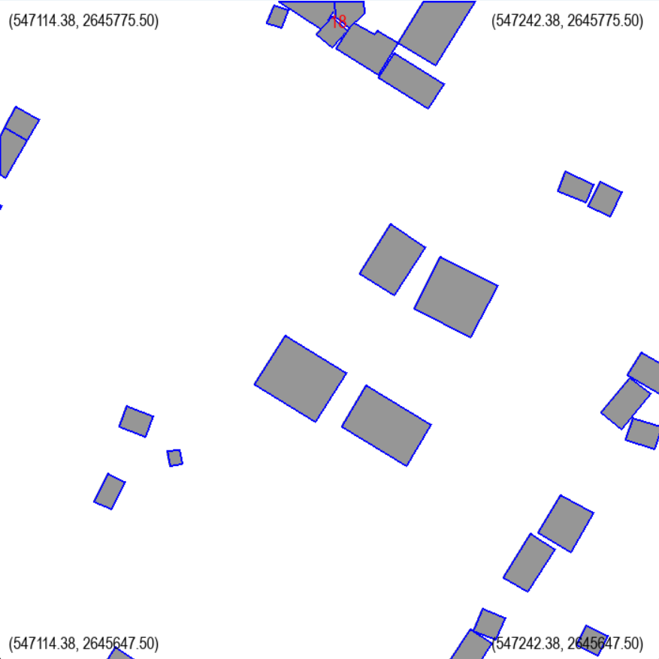
MLP Approach
For small scenes: say for 128 x 128 m² scenes

Slide 3
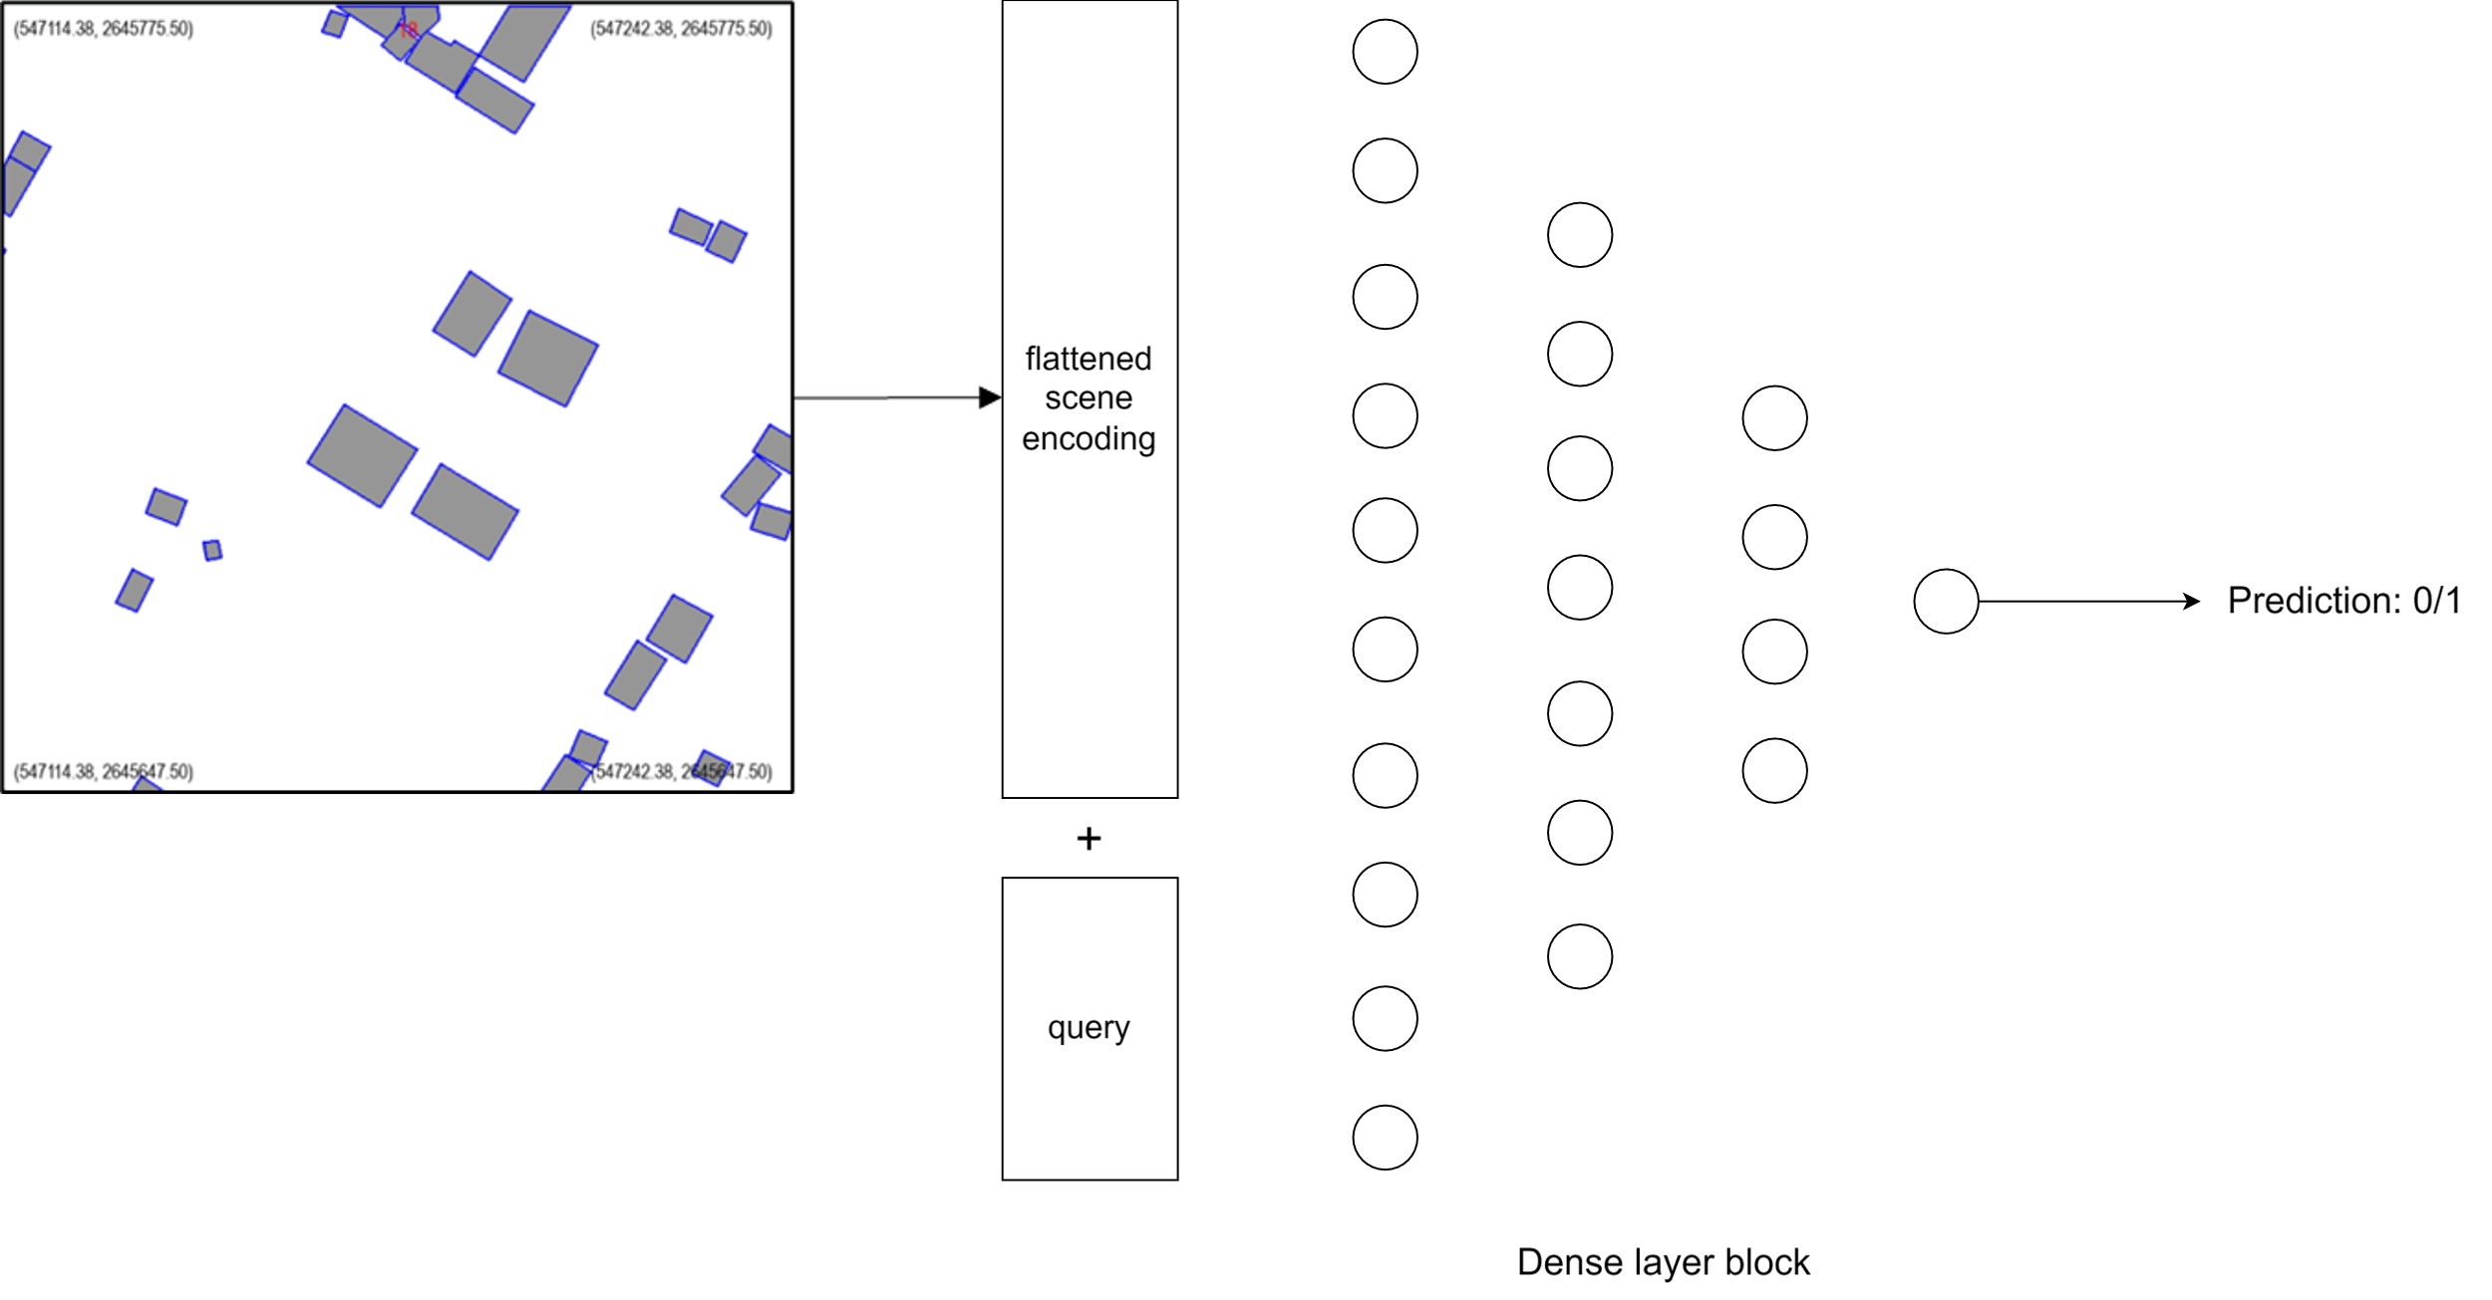
MLP Approach
For small scenes: say for 128 x 128 m² scenes

Slide 4
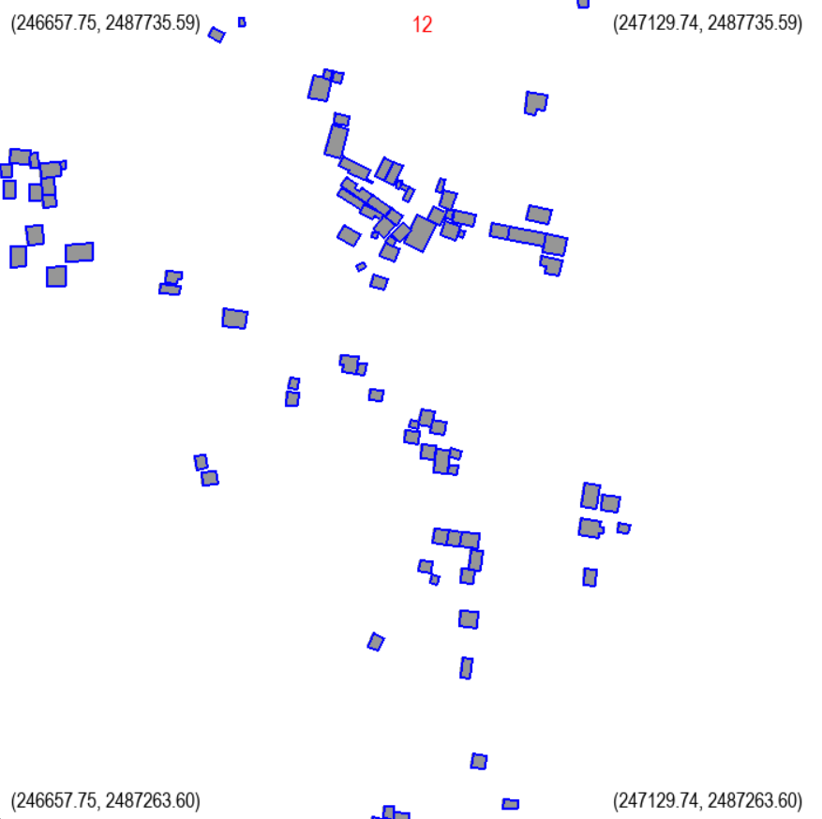
MLP Approach
For large scenes: say for 512 x 512 m² scenes

Slide 5
MLP Approach
For large scenes: say for 512 x 512 m² scenes
128 m
128 m

Slide 6
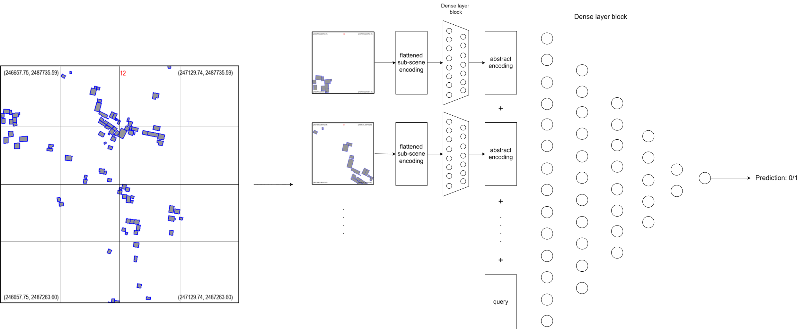
MLP Approach
For large scenes: say for 512 x 512 m² scenes

Slide 7
MLP Approach
Our Concerns:
Scene encoding part of input is constant for every sample. This part has no correlation with output label. So, one can argue that this part can be removed.

Slide 8
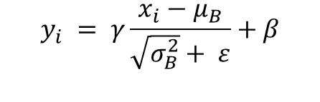
MLP Approach
Our Concerns:
Scene encoding part of input is constant for every sample. This part has no correlation with output label. So, one can argue that this part can be removed.
Keeping this constant scene encoding part is problematic for using layers like batch normalization as this data has no variance across batch.
$$y_{i} = γ\frac{x_{i}−μ_{B}}{\sqrt{σ_{B}^{2}}+ ε}+β$$

